Slide 1

PLR: a software approach to transient fault tolerance for multicore architectures
Alex Shye, Joseph blomstedt, tipp moseley, vijay janapa reddi e daniel a. connors
Ieee transactions on dependable and secure computing, vol.6, n°2, aprile-giugno 2009

Slide 2
Introduction
Transient faults = event that invert the state of a transistor
The inverted value may propagate to cause an error in program execution
Number of available transistor per chip grows exponentially
Error rate of an entire chip is expected to increase dramatically

Slide 3
introduction
Custom solutions:
Add redundancy adding logic to mainframe processor
Specialized machine with custom hardware and software redundancy
General-purpose systems cannot adopt these customized techniques
Application specific constraints
Fault during the execution of a bank transaction
Fault during graphic processing or audio decoding
Design time and cost constraints
Low cost and quick time to market
Redundancy = cost
Post-design environment techniques
Fault can appears after design and fabrication
Altitude, temperature, age , … = higher fault rates

Slide 4
introduction
Software reliability techniques are an attractive solution
Zero hardware design cost
Flexible deployment
Existing software use the compiler to insert redundant instruction
Decrease performance
Recompilation of all application
Source code is often unavailable
PLR (process-level redundancy) creates a set of redundant process and compares their output
No additional redundant hardware structures
Operates transparently to the application

Slide 5
background
Transient fault can be classified by its effect on system execution
Benign fault = transient fault that does not propagate to affect the correcteness of an application
Silent data corruption (SDC) = a transient fault that is undetected and propagates to corrupt program output
Detected unrecoverable error (DUE) = transient fault detected without the possibility of recovery
A True DUE occurs when a fault that would propagate to incorrect execution is detected
A False DUE occurs when a benign fault is detected as a fault

Slide 6
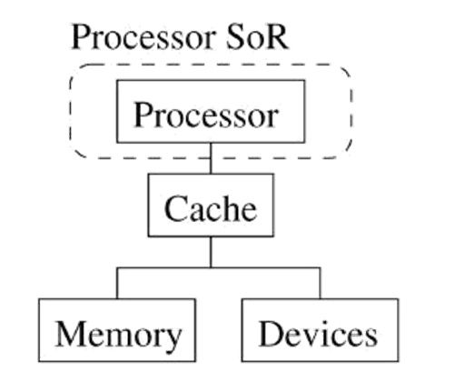
hardware-centric fault detection
Sphere of replication (SoR) describes a technique’s logical domain of redundancy and specify the boundary for fault detection and containment
Any data that enters the SoR is replicated
Any execution within the SoR are redundant in some form
Any output data is compared before leaving the SoR
The hardware-centric fault detection model view the system as a collection of hardware components

Slide 7
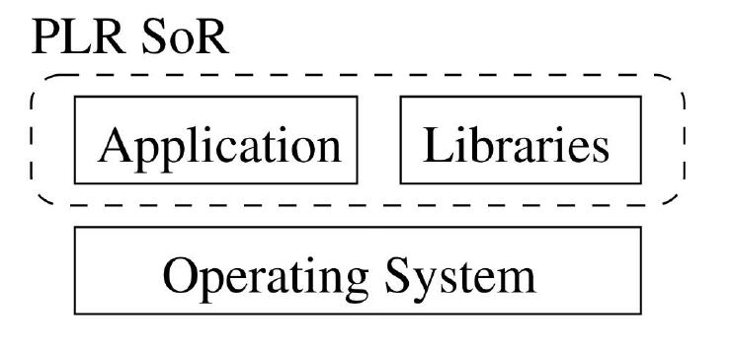
software-centric fault detection
Software-centric fault detection model is a paradigm in wich the system is viewed as the software layers that must execute correctly
The only faults that matter are the faults that affects software correctness

Slide 8
Process level redundancy (plr)
Transparency
Software implemented
Software centric
Replica-based

Slide 9
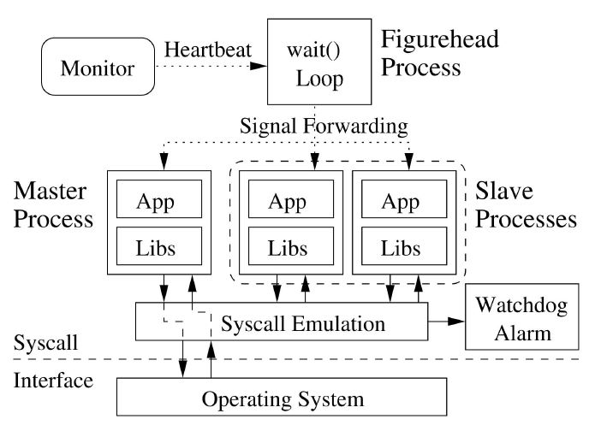
PLr overview

Slide 10
Maintaining process semantics
Pid consistency
Correct exit code
Signaling
In order to maintain process semantics, PLR uses a figurehead process
Sleeps and waits on the redundant processes
Receives the application’s exit value from the system call emulation unit and exits
Performs signal forwarding

Slide 11
Process replicas
During execution one of the redundant processes is logically labeled master the others are slave
At each system call the system call emulation unit is invoked and it performs:
Input replication
Output comparison
Fault recovery
It also ensures that the following requirements are mantained:
The execution of the redundant process must be transparent to the system environment
The execution among the redundant processes must be deterministic
All redundant processes must be identical

Slide 12
input replication
Any data that passes into the processes is received once by the master process and then passed to the slave processes
During system call emulation, any read data is replicated and copied to the slave processes
The return value from all system calls is considered as input data and is replicated

Slide 13
output comparison
Must be compared:
All data that exit the redundant processes
Any write buffers that will be passed outside the SoR
Any data passed as a a system call parameter
Small amount of data = copying data to shared memory segment and comparing bytes
Larger write buffers = local creation of a 32-bit CRC and then the CRC value is compared through shared memory

Slide 14
Emulating system calls
At the beginning of each call to the emulation unit, the type of system call is compared to ensure that all redundant processes are at a common system call
System call emulation unit will perform different tasks in case of different system calls:
Modify any system state(file renaming, linking, etc) are executed once by the master process.
In other cases the system call will be called by all processes, once by the master process in its original state and once by each redundant process to emulate the operation

Slide 15
Shared memory
Potential nondeterminism between redundant processes
Trap and emulate
Any system calls regarding shared memory is a special case
PLR updates a shared memory map (SMM)
PLR switches the protection of all the shared memory pages
Trap handler in PLR decodes and begins to emulate the instruction
High overhead
Trap and emulate and probe
Placing a probe at the offending instruction after a trap
Emulate a specific instruction

Slide 16
Asynchronous signals
Another form of potential nondeterminism
Figurehead process take care of the first part of signal processing
Signal handlers are called asynchronously and may read or write any data in the process’s address space
PLR inserts probes and marks specific points in the code as epoch boundaries
An epoch is a timeslice of a program in wich the start and end points are known and identical across the redundant processes
Signal handling is deferred and handled at epoch boundaries

Slide 17
Asynchronous signals
Figurehead receives the asynchronous signal
It sends a SIGSTOP to all the redundant processes
It inspects the epoch counter of each redundant process
A pending signal is set up to be serviced at an epoch count equal to the largest current epoch counter plus one
It resumes the execution of all redundant processes
The redundant processes execute and, at each epoch boundary, check if there is a pending signal to be handled

Slide 18
Transient fault detection
Output mismatch
Transient fault will be detected with the output comparison
Watchdog time-out
A fault cause an error in control flow, wich calls an errant system call
Transient fault cause a process to hang indefinitely
Program failure
Segmentation violation, bus error, illegal instruction
Signal handlers are set up to catch the corresponding signal

Slide 19
Transient fault recovery
The killed process are replaced by duplicating a correct process
Output mismatch
The process with incorrect data are immediately killed
Watchdog time-out
There is only one process in the emulation unit and it will be killed
All processes are in the emulation unit except one that will be killed
Program failure
Incorrect process is already dead

Slide 20
Windows of vulnerability
All fault tolerance techniques have windows of vulnerability, wich are usually associated with faults to the checker mechanism
Figurehead process is a single point of failure but it performs almost no real work and the probability of a transient fault affecting its execution is very low
A single monitor process also represents a single point of failure but it can be replicated
Although not completely reliable, partial redundancy may be sufficient to improve reliability enough to meet user or vendor reliability standards

Slide 21
Experimental results
The prototype is built using the Intel Pin dynamic binary instrumentation system
The tool uses Pin to dynamically create redundant processes and PinProbes to intercept system calls
Evaluated running a set of the SPEC2000 benchmarks
One thousand runs are executed per benchmark
For each run a dynamic instruction is used to randomly choose a specific invocation of an instruction to fault (switching a random bit)
Performance is measured by running the prototype with both two and three redundant processes on a four processor system

Slide 22
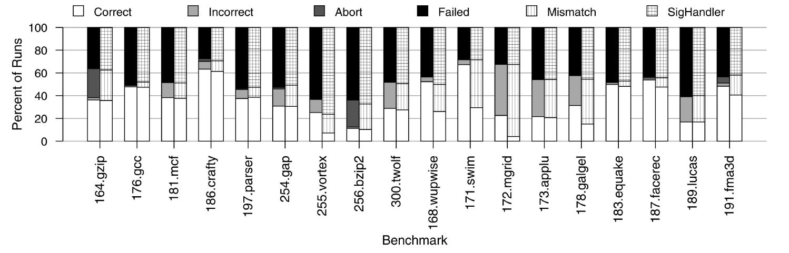
Fault injection results
Time-outs of the watch-dog alarm are ignored because they occur very infrequently (∼0,05% of the time)

Slide 23
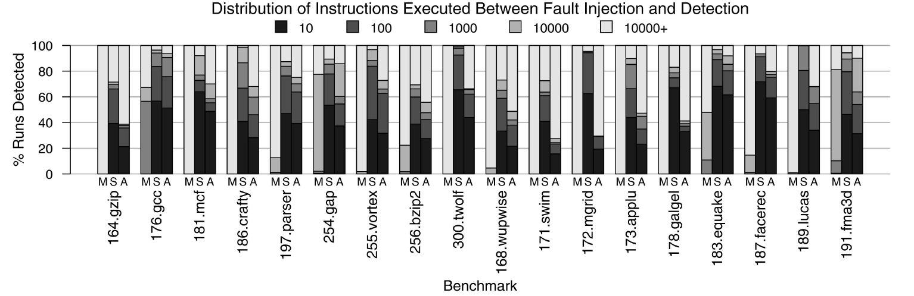
Fault propagation

Slide 24
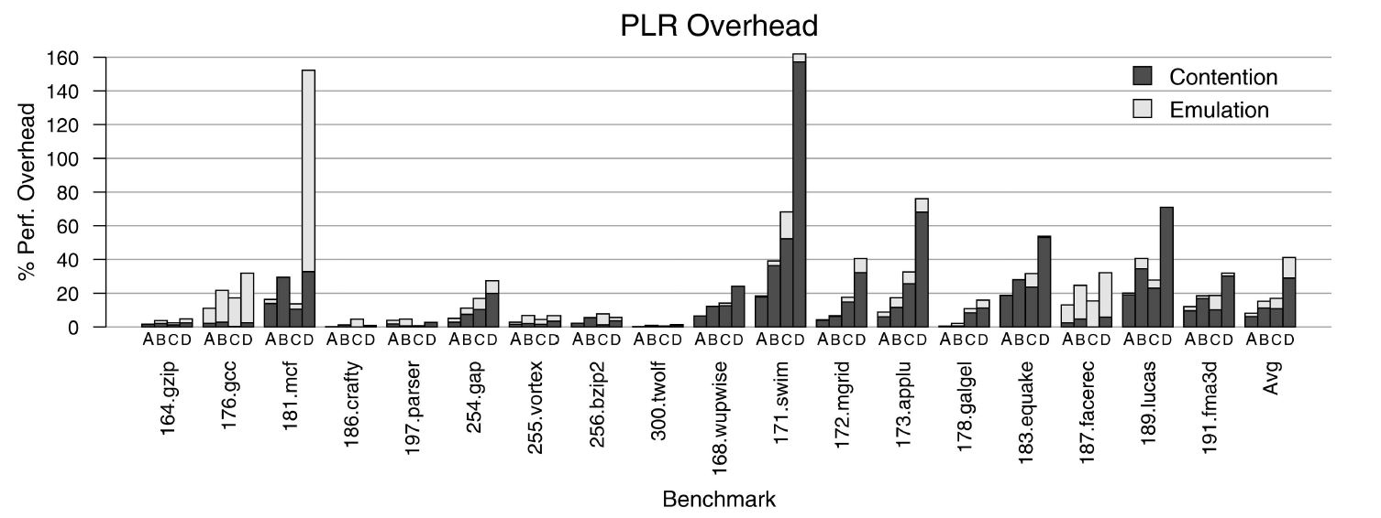
Performance results
Two redundant processes for fault detection, three to support recovery

Slide 25
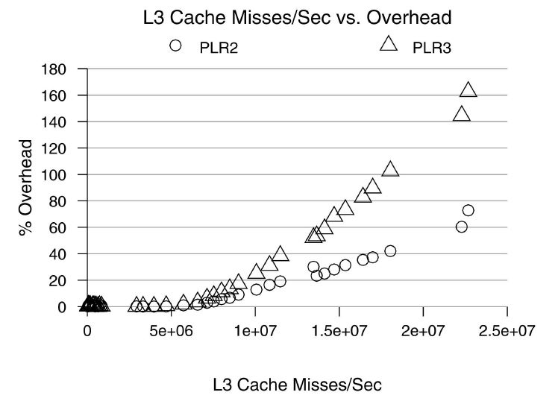
Contention overhead
Sharing memory bandwidth between multiple redundant processes
CPU-bound applications very low overhead vs. memory-bound applications high overhead

Slide 26
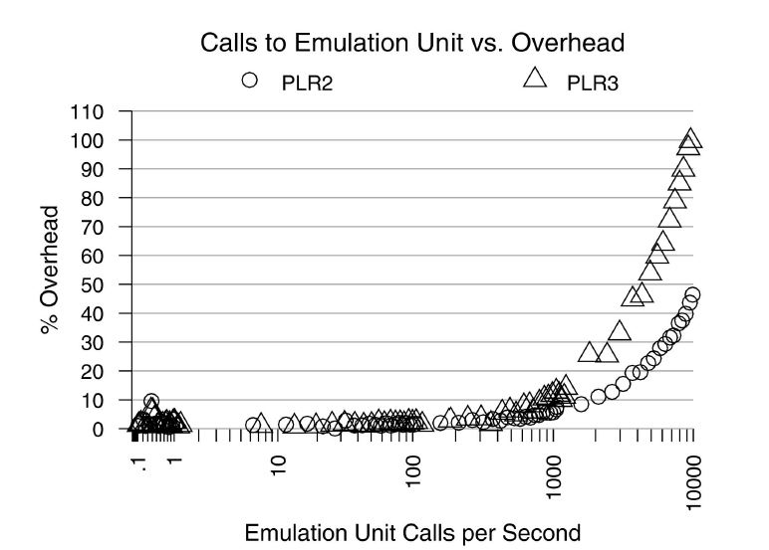
Emulation overhead
PLR technique might be best deployed for specific application domains without significant system call functionality

Slide 27
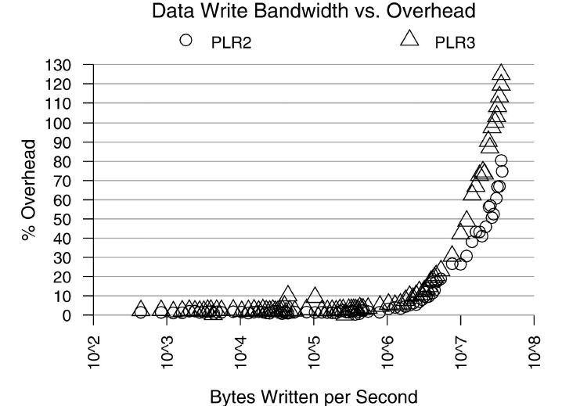
Emulation overhead
Evaluates the amount of data at each system call that must be compared between redundant process techniques.

Slide 28
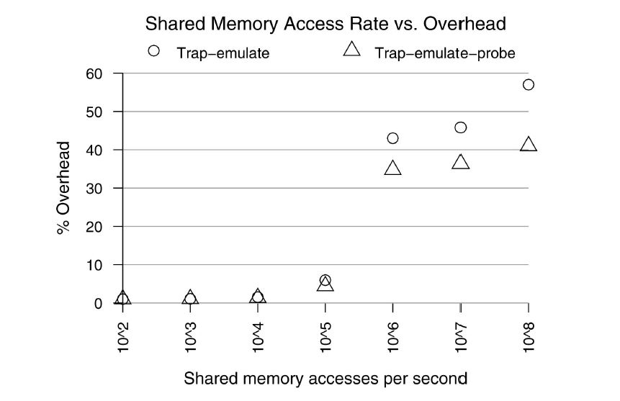
Shared memory support
Benchmark that periodically writes to a shared memory region

Slide 29
conclusion
PLR is an attractive alternative in emerging multicore processors
Providing redundancy at the process level, PLR leverages the OS to freely schedule the processes to all available hardware resources
PLR can be deployed without modifications to the application, OS or underlying hardware
PLR’s software centric fault detection model detects faults and safely ignores benign faults
PLR provides fault detection with a 16,9 percent (mean) overhead
Comparable performance to hardware techniques

